Slide 1
Vet For Every Pet
Pharmacy & Pet Clinical Management System
Presented to Dr. Sahar Fawzy
& Eng. Omnya Saeed

Slide 2
Table of contents
Introduction | A) Problem definition B) Objective
Methodology | A) Technologies used B) API implementation
Results | A) Website B) Pharmacy
Discussion and conclusion | Achieved clinical management system
Future Work | Incorporate new features and functionalities
Team Members | Meet our team

Slide 3
01
Introduction

Slide 4

Introduction
Pet clinics are regarded as one of the most essential clinics owing to the significance of animal health since many people own pets and expose their children to these animals on a regular basis. Furthermore, the necessity for transforming the outdated pet clinical systems and actual demand has increased because of the new generation of produced technology. That’s why we created two interfaces which are a clinic pet website and a pharmacy alongside the main clinic system.

Slide 5
Introduction
Problem definition
The Pet history can't be found by using the old way of clinical systems
The necessity for transforming the outdated pet clinical systems and actual demand has increased as a result of the new generation of produced technology.
The system is required to keep track of patients, appointments, procedures, and medicines.

Slide 6
Introduction
Objective
Provide decision support for doctors.
Developing independent systems with the functionality each department in the hospital need, while connecting and integrating all of these systems to make data exchange between them easier.
Coordinating the workflow of the veterinarians, including keeping track of the animals, appointments, treatments, and medications.
Each Pet's profile is saved in the system database, making it simple to locate, manage, and update regularly.
Supporting more data formats makes it easier to integrate software and achieve interoperability in the healthcare sector.

Slide 7
02
Methodology

Slide 8
Methodology
Gathering and Analysis
System Design
Desktop Application Development
Testing
Deployment and Maintenance
Vet for Every Pet Website Integration
Pharmacy and Web Clinic Website Integration
Continuous Improvement

Slide 9
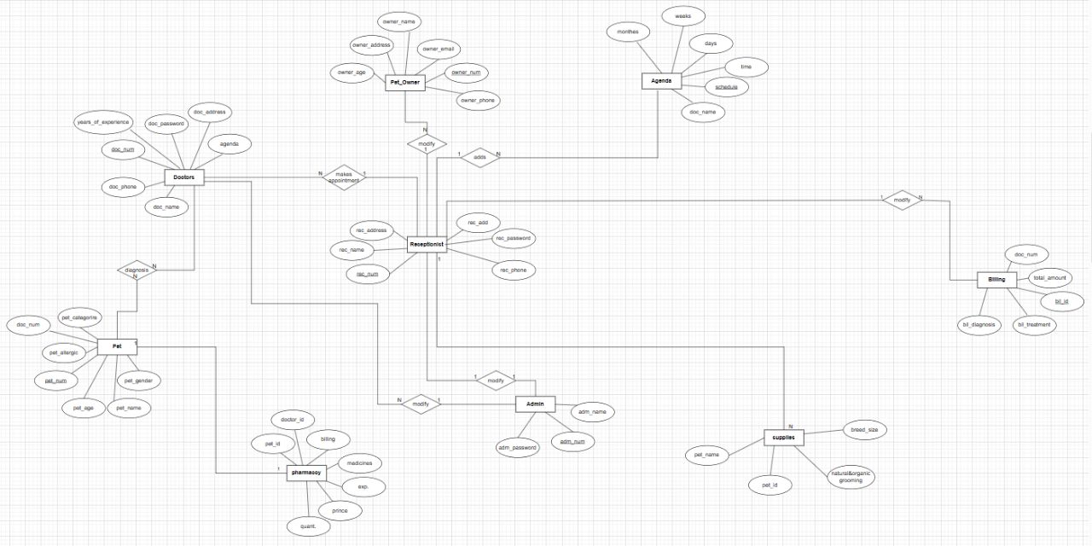
Methodology Uml Digaram

Slide 10
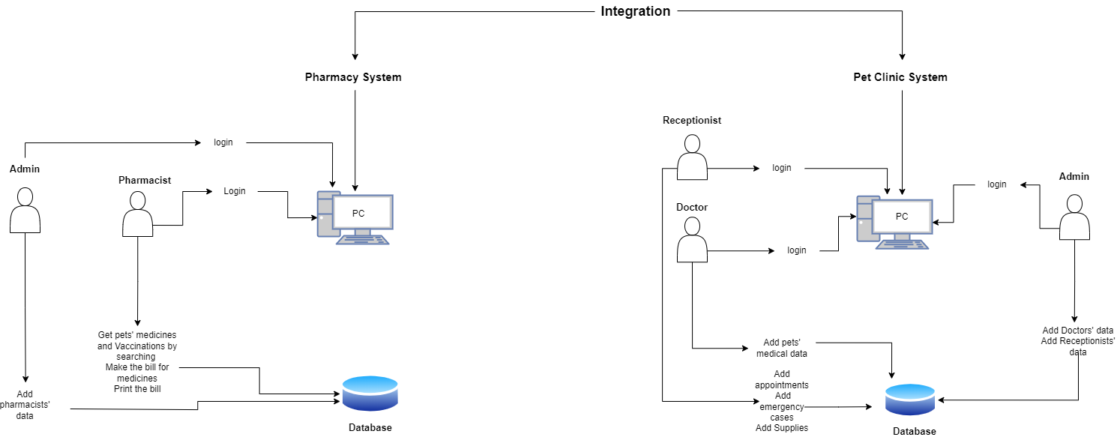
Methodology High Level Architecture

Slide 11
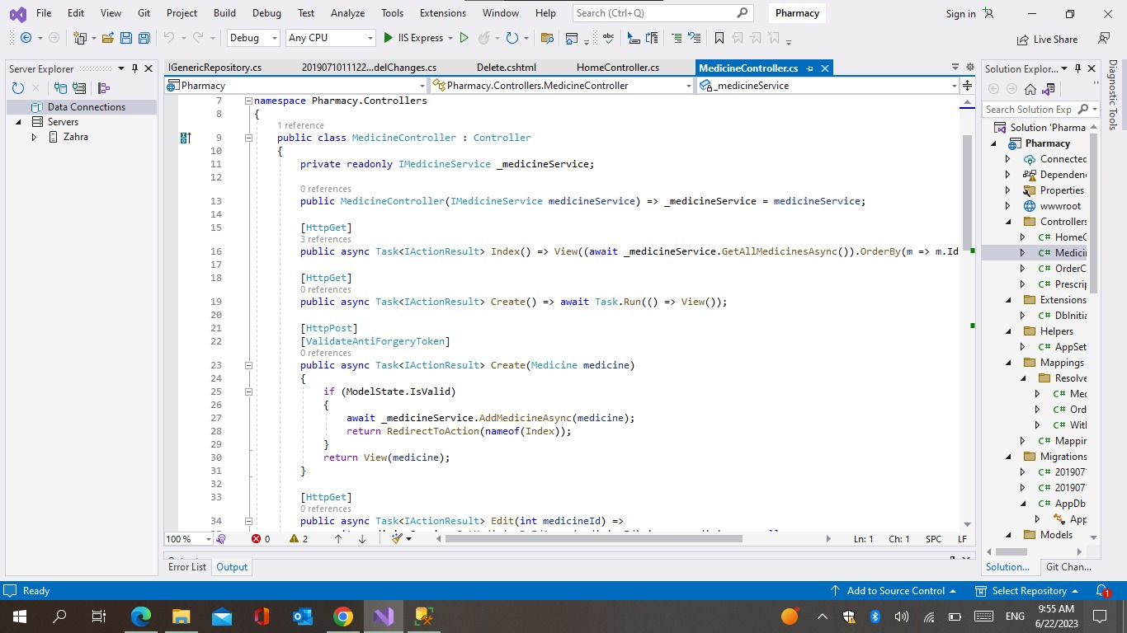
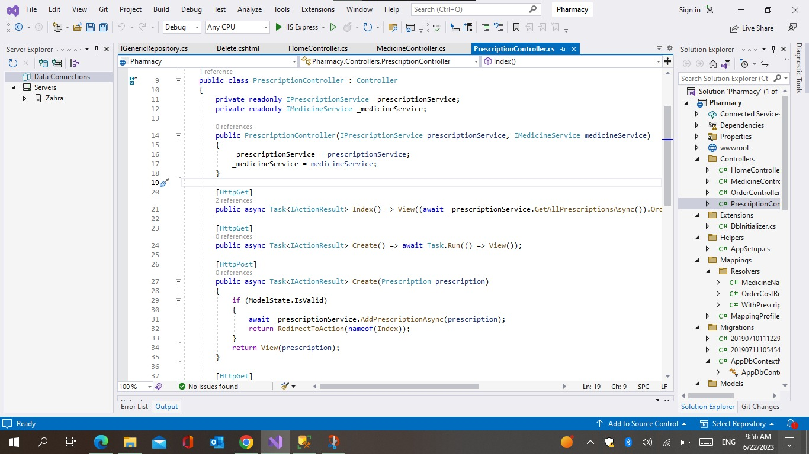
Methodology Pharmacy API implementation

Slide 12
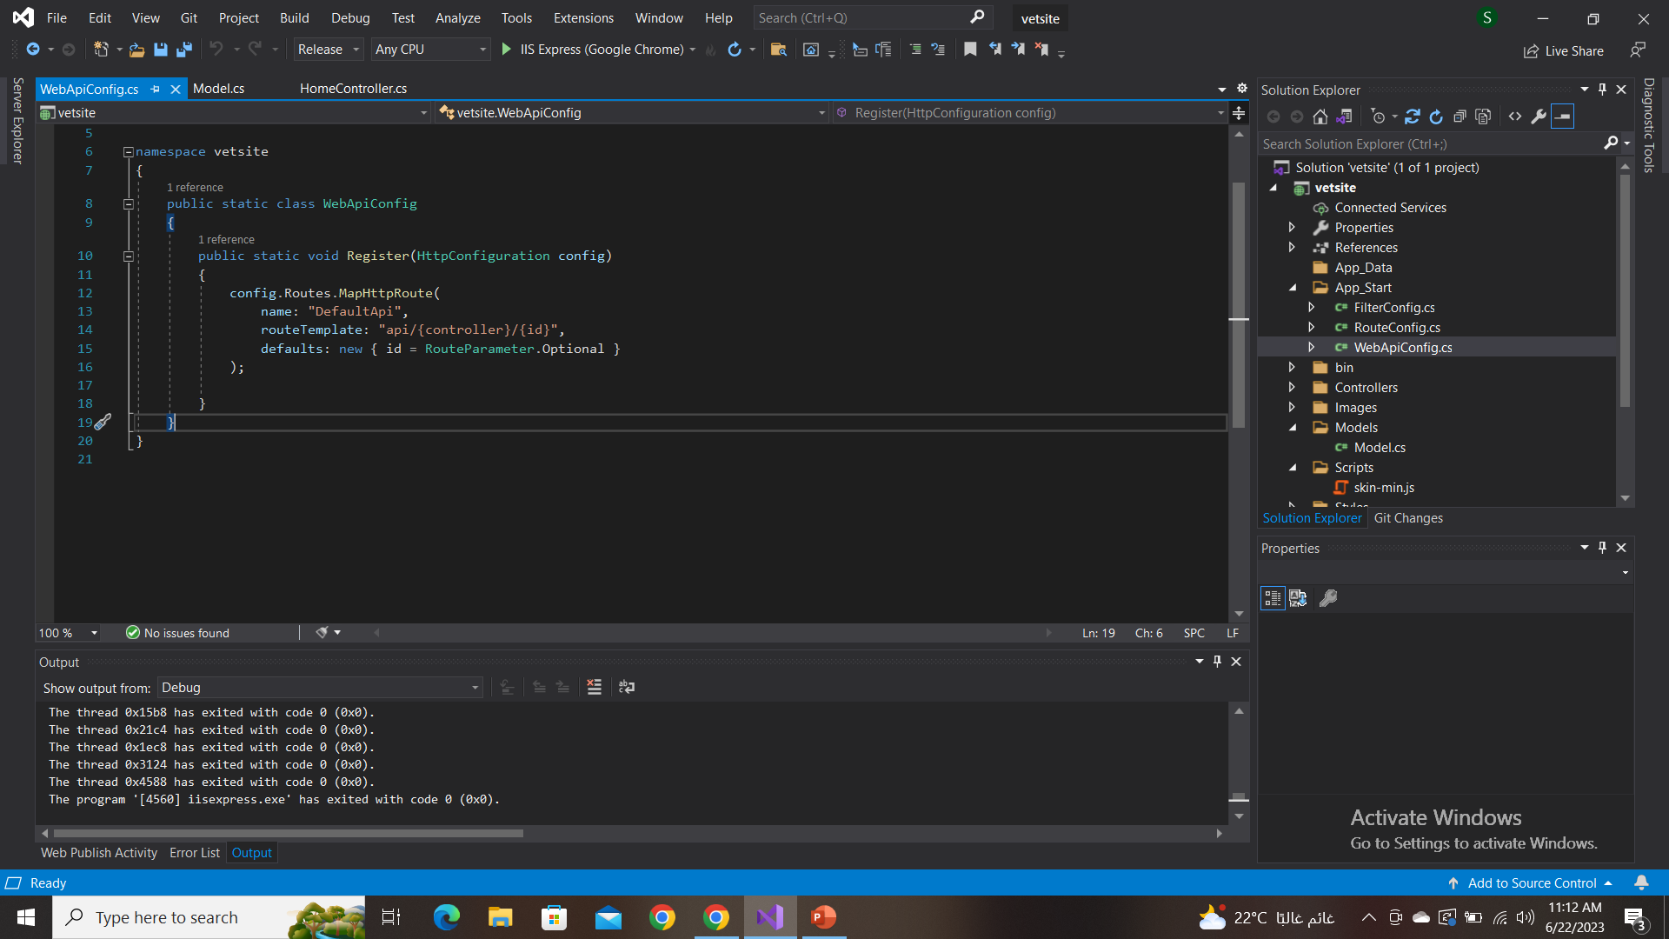
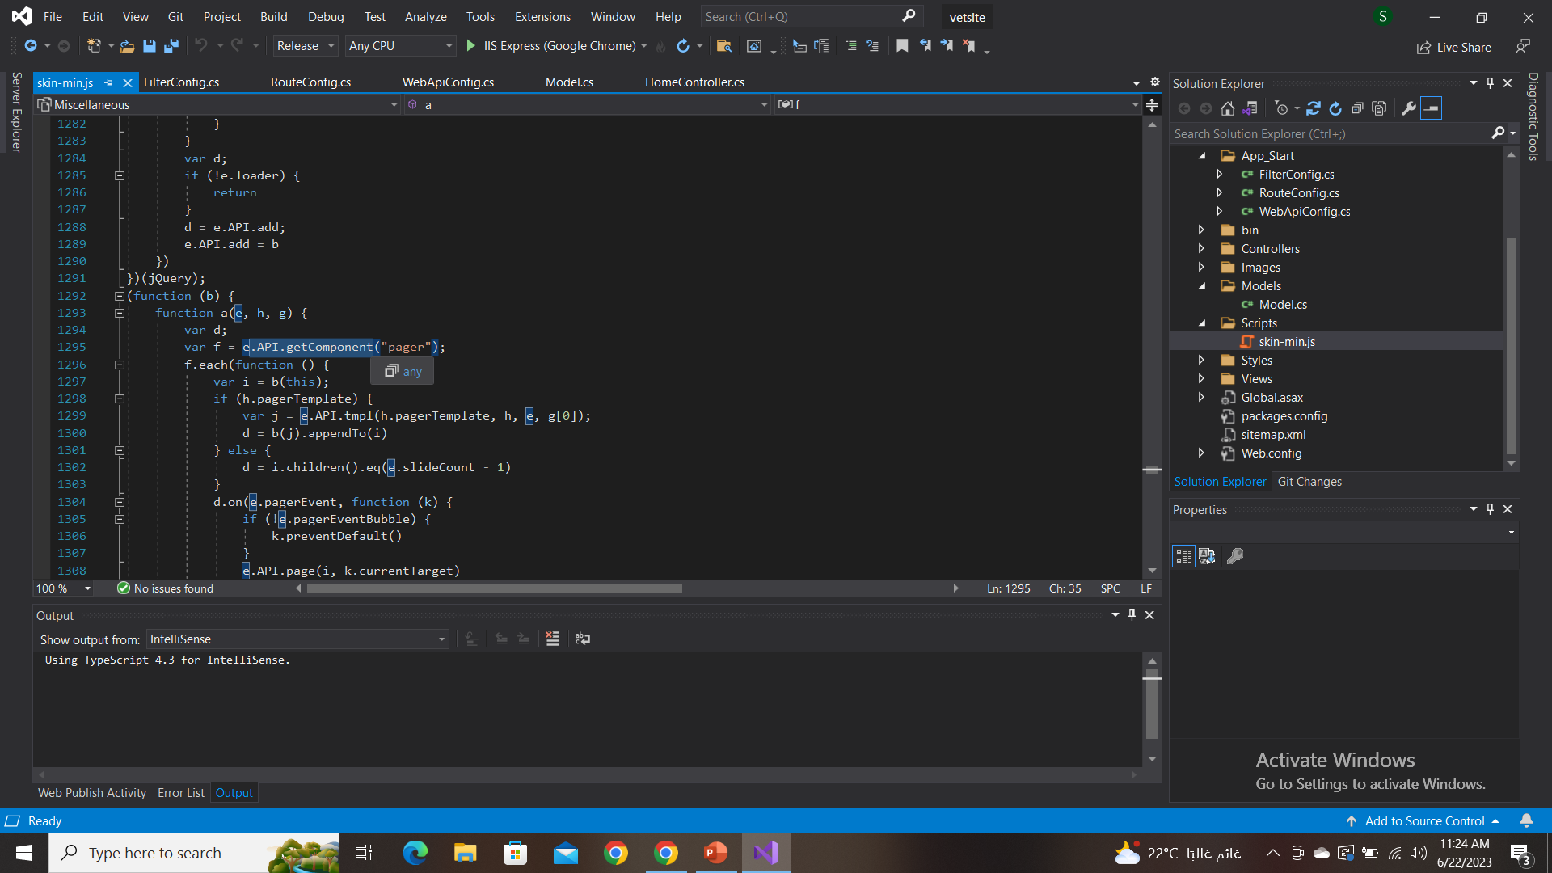
Methodology VFEP API implementation

Slide 13
03
Results

Slide 14
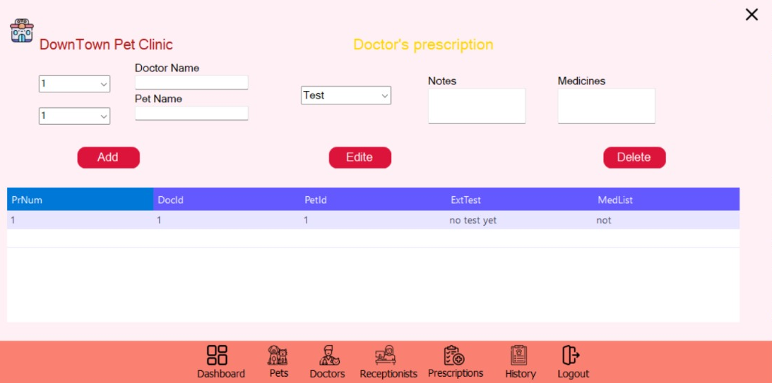
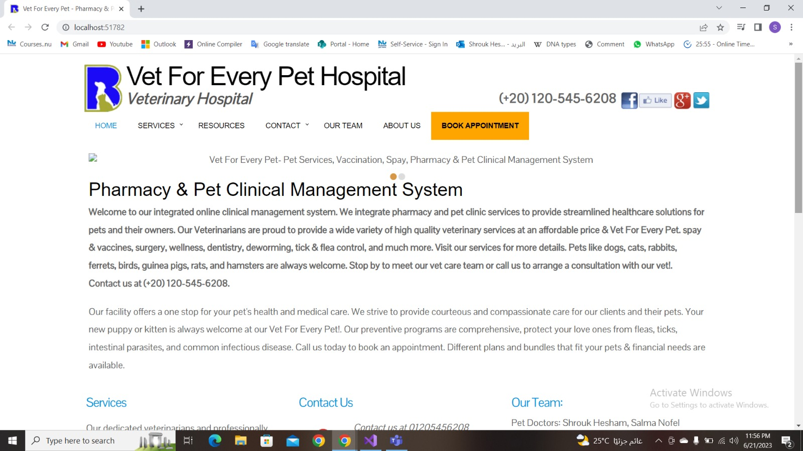
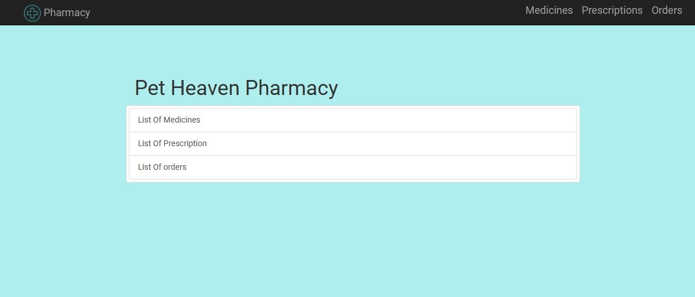
Results
Here are our two interfaces and we will proceed with the demo

Slide 15
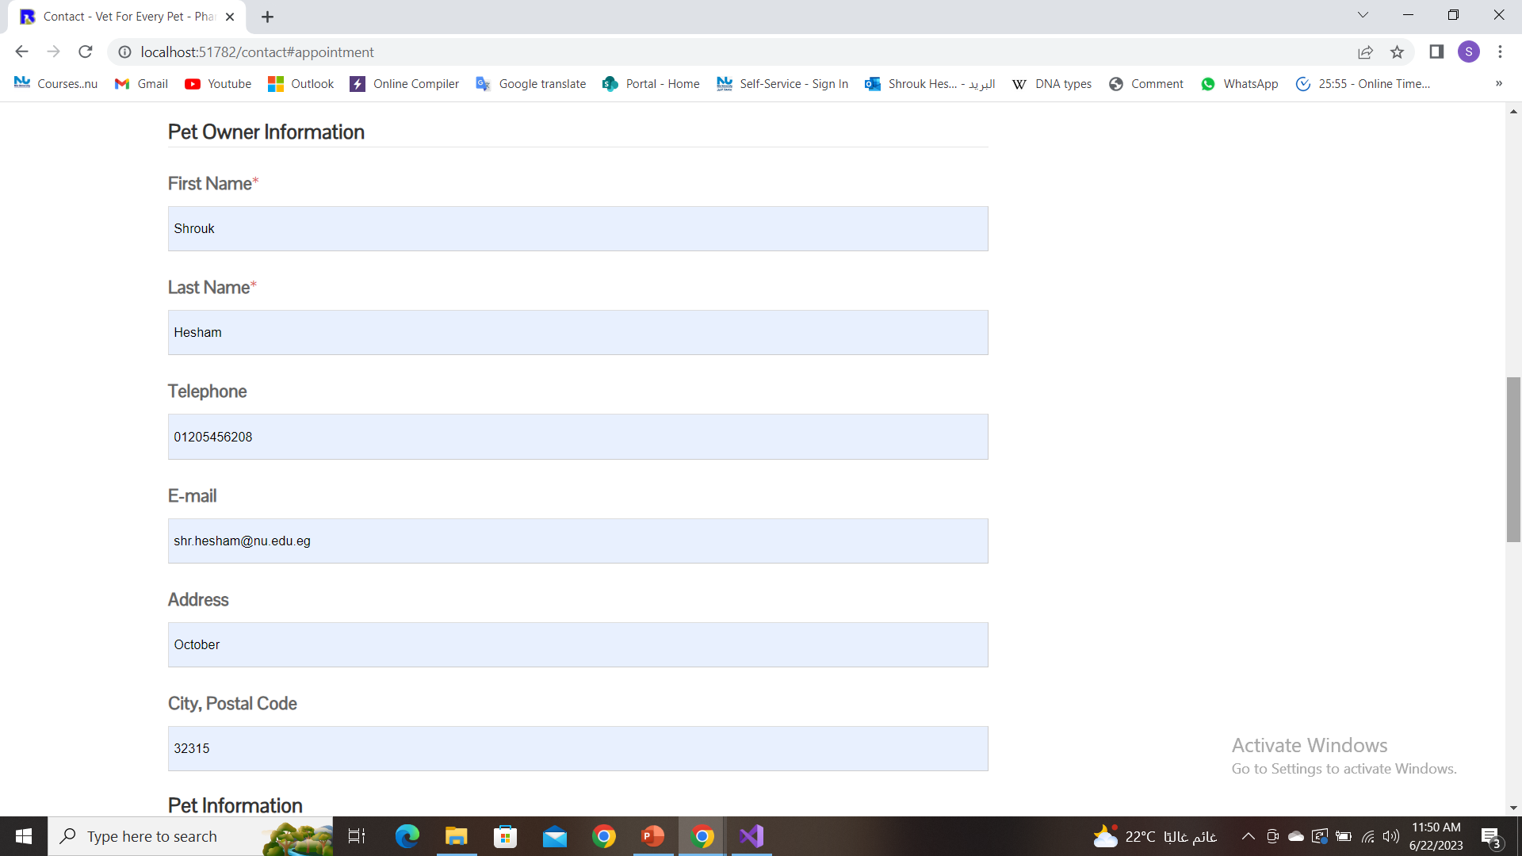
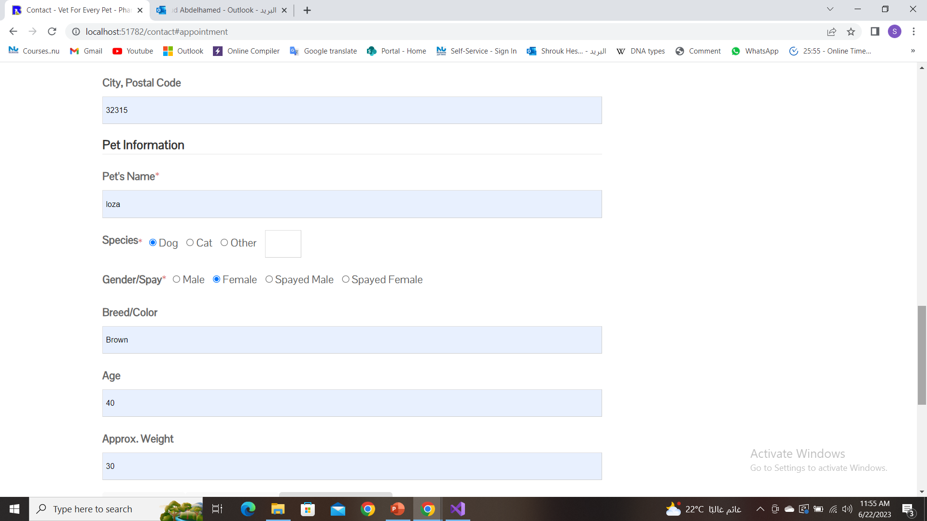
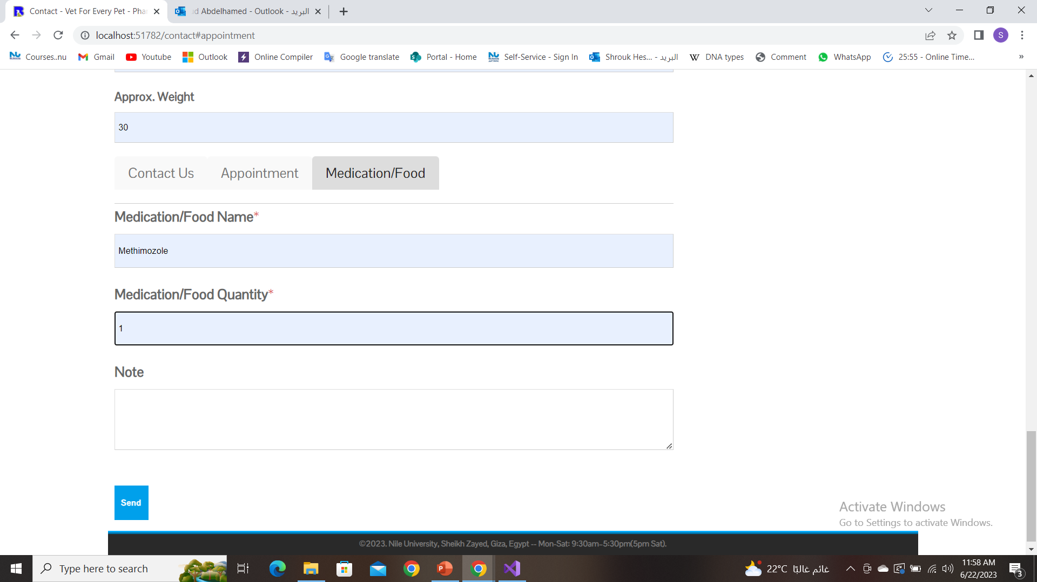
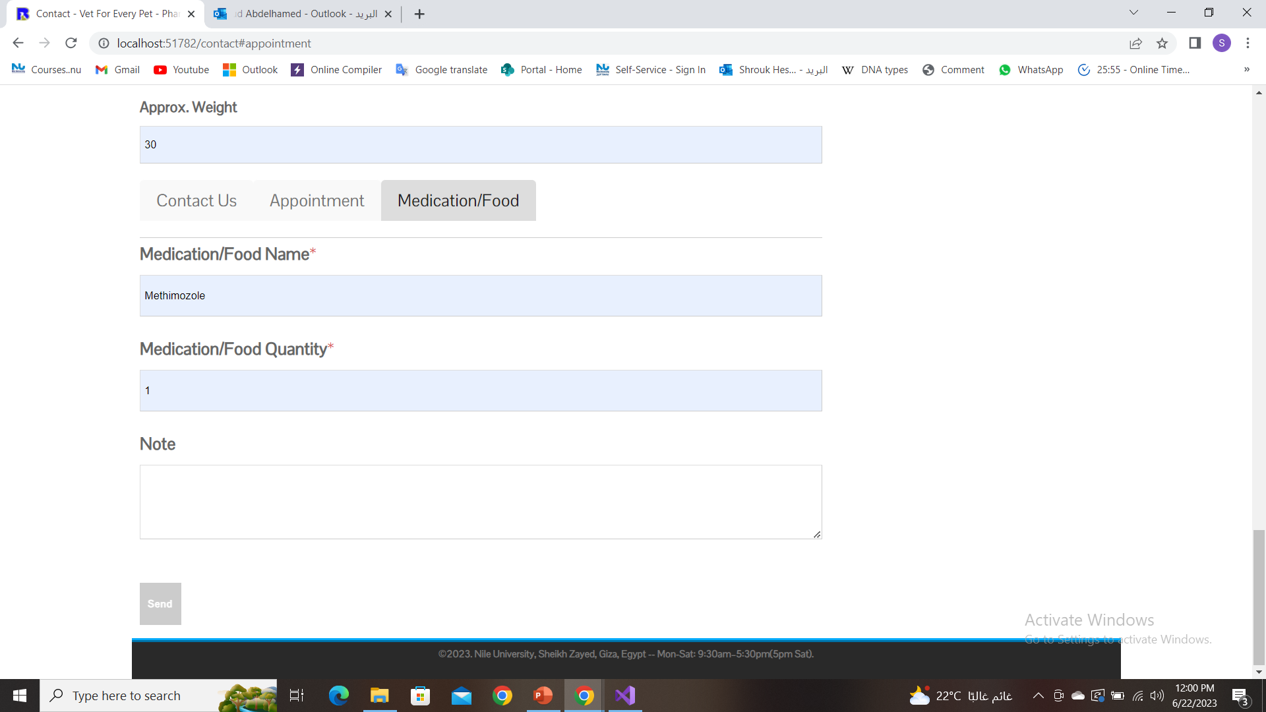
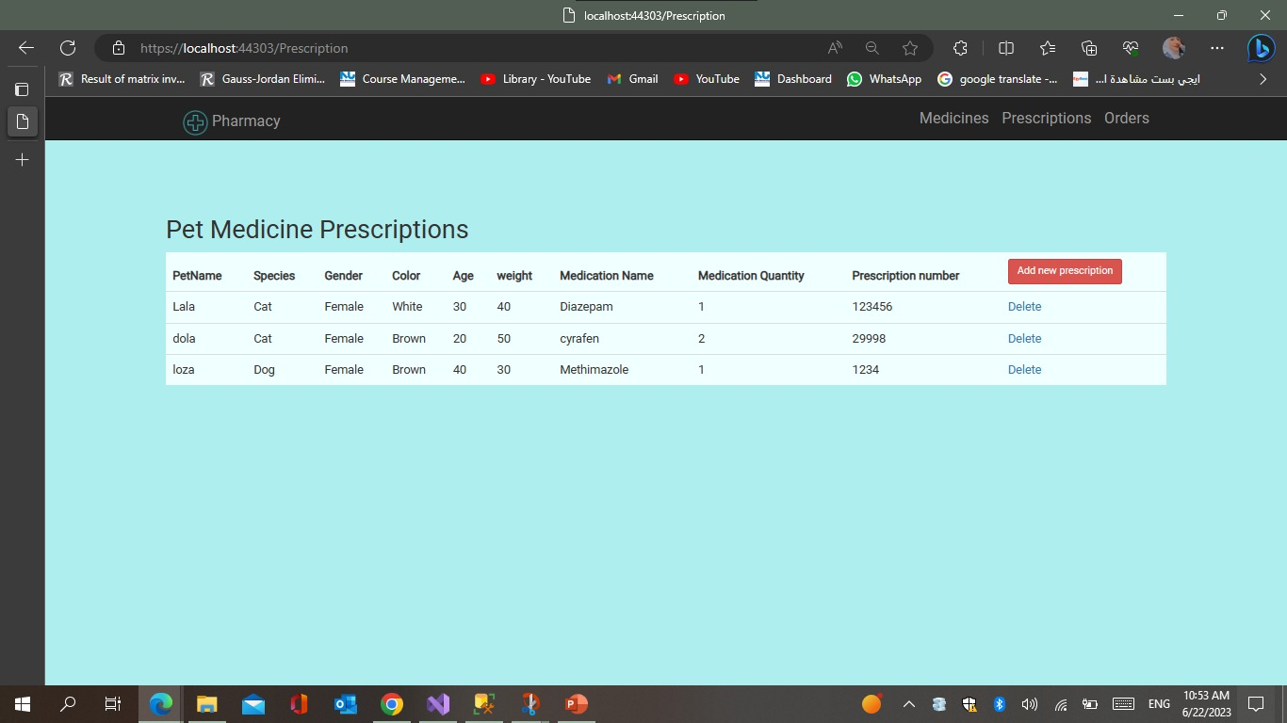
Results
See our result with API clinics integration

Slide 16
04
Discussion and Conclusion

Slide 17
Discussion and Conclusion
Overall, the designed desktop application has successfully addressed the veterinarian's workflow management and pet tracking needs. The integration with the pharmacy and web clinic website has enhanced the application's capabilities and provided a comprehensive solution for veterinary clinics

Slide 18
05
Future Work

Slide 19
Future Work
In our future work, enhancements and improvements to the desktop application will be added like developing a mobile application version of the veterinary management system. In addition to, telemedicine Integration explore the integration of telemedicine capabilities within the application to allow veterinarians to remotely diagnose and treat certain conditions. This would provide convenience for pet owners and expand the reach of veterinary care.

Slide 20
06
Team Members

Slide 21
Our Team:
Shrouk Hesham Mahmoud | 19106271
Elzahraa Saeed | 19106429
Login Darwish | 19105985
Alaa Mamdouh | 19106209
Salma Ismail | 18101502
Salma Sameh | 202002800

Slide 22
Thanks!
Do you have any questions?

